Slide 1
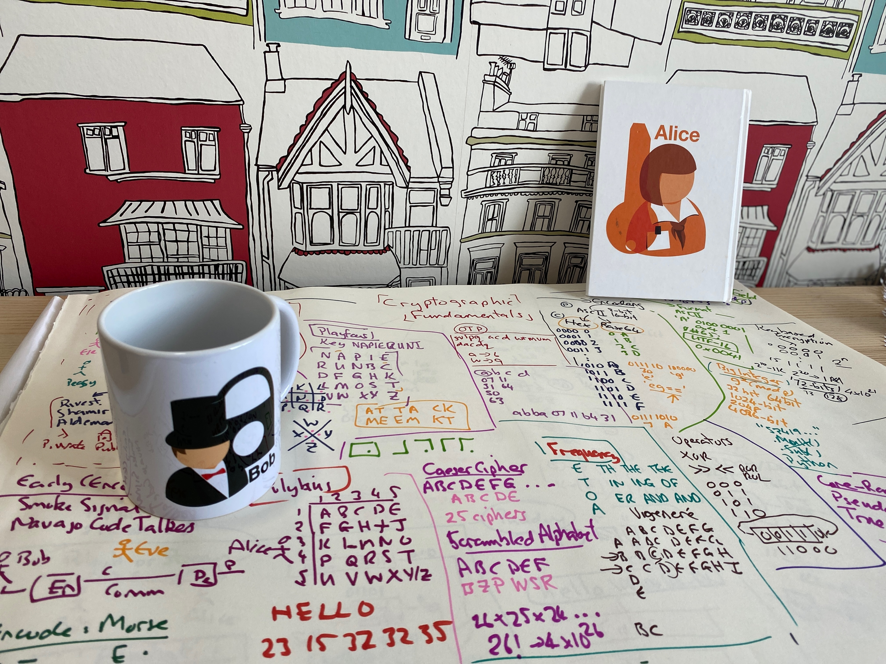


Introduction
Module Overview Timetable vSoC 2 Prof Bill Buchanan OBE https://asecuritysite.com

Slide 2

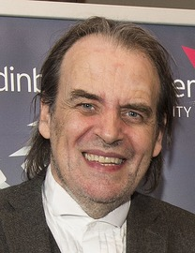
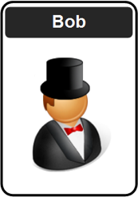


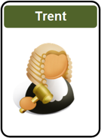
Professor Bill Buchanan OBE. Research into cryptography, blockchain and identity. Leads with Blockpass ID Lab.
Twitter: @billatnapier Web: asecuritysite.com

Slide 3
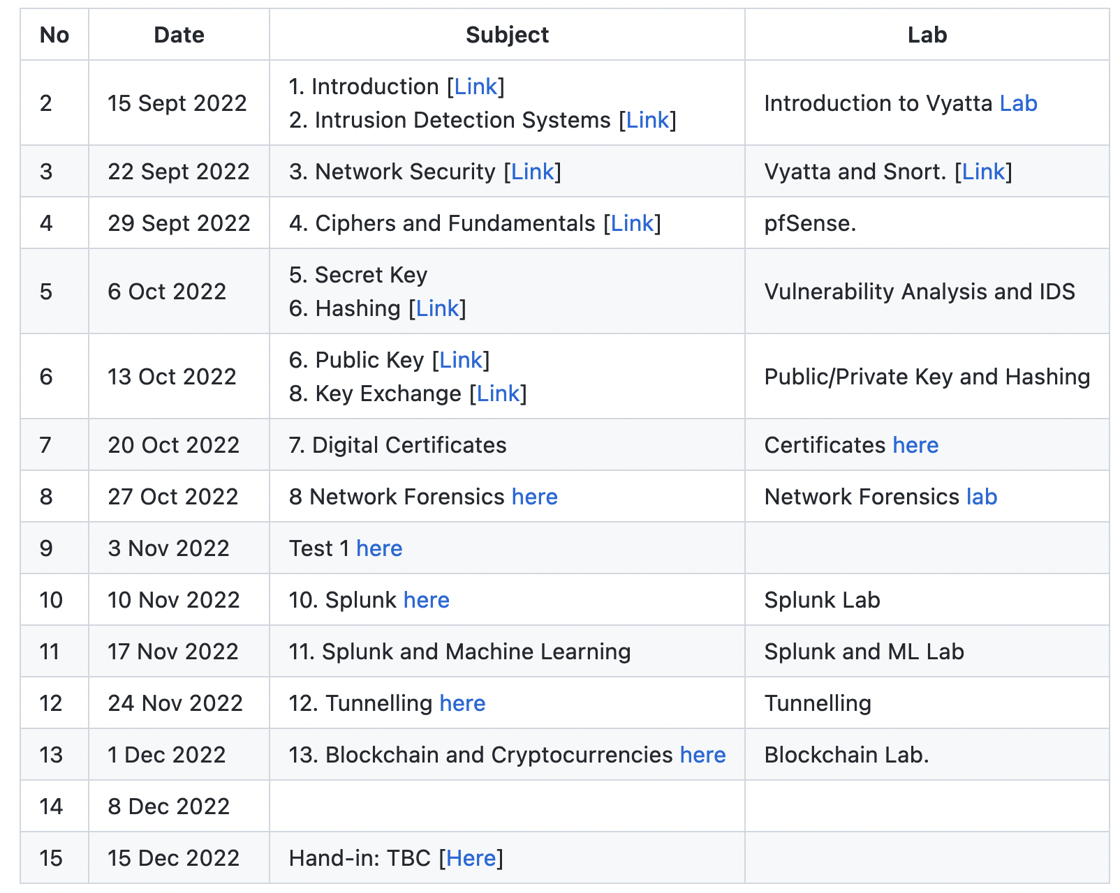
git clone https://github.com/billbuchanan/csn09112

Slide 4
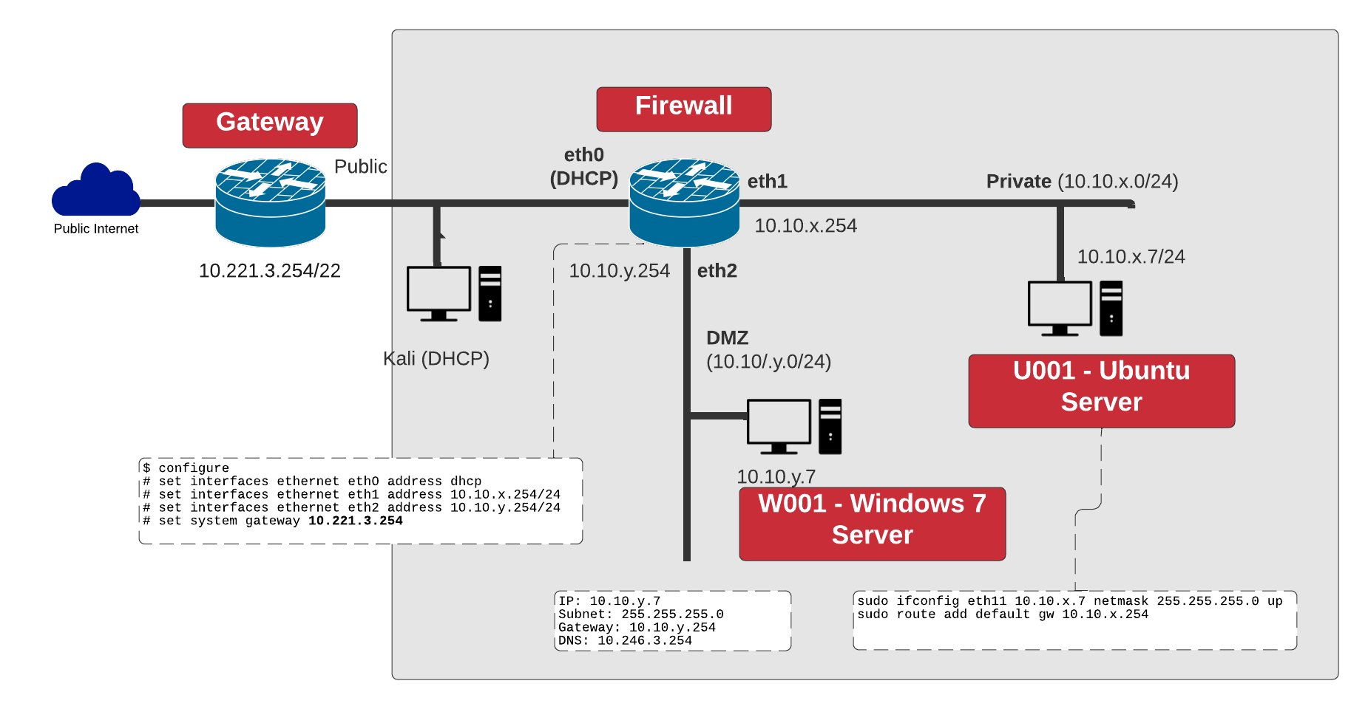

Slide 5
Introduction
Module Overview Timetable vSoC 2 Prof Bill Buchanan OBE https://asecuritysite.com

